Slide 1
PAY AND GO

Slide 2
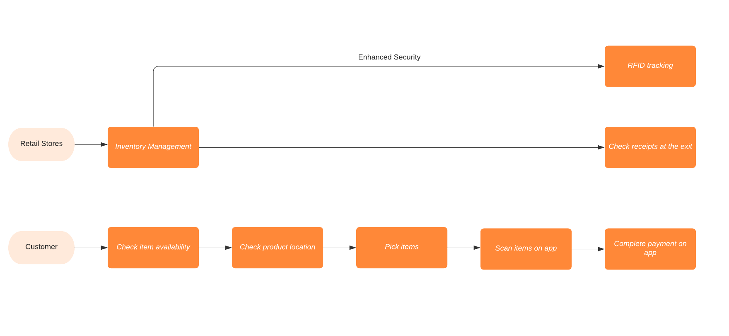
PAY AND GO - WORKFLOW

Slide 3






Competition
Direct
Indirect

Slide 4
END USER PROFILE
User Profiles

Slide 5
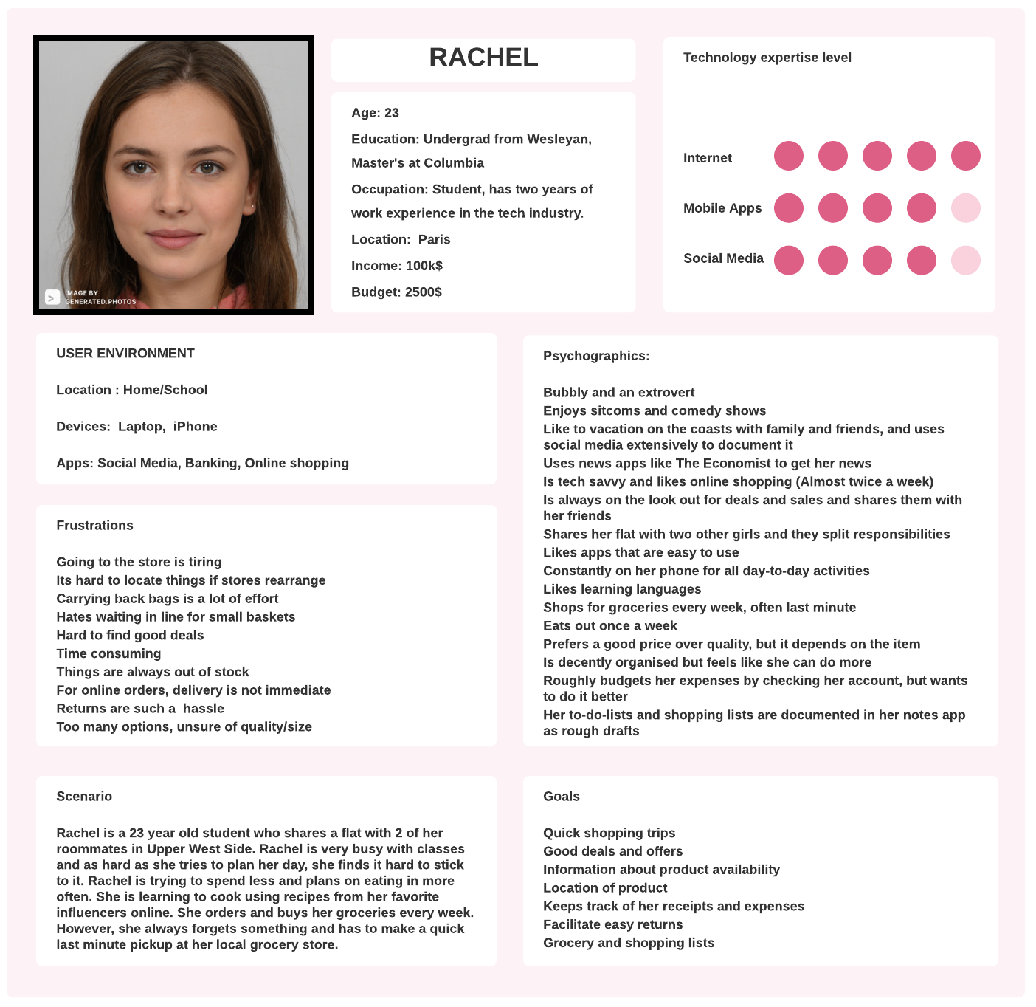
END USER PERSONA

Slide 6
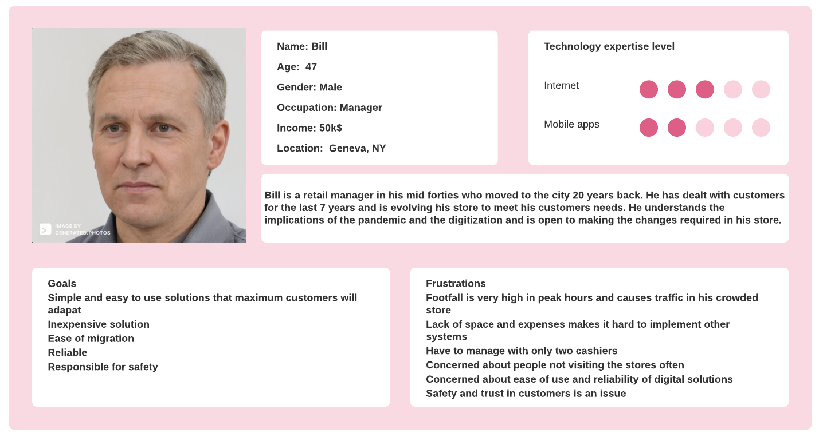
STORE MANAGER PERSONA

Slide 7
TAM
TAM

